Slide 1
7th Presentation
Made by : Fareed Waleed
Reg : 20102302

Slide 2
implement a logistic regression model
We will implement a logistic regression model using different optimization techniques like Gradient Descent, Stochastic Gradient Descent, Mini-batch Gradient Descent, and Batch Gradient Descent. The project also requires generating synthetic data, calculating loss at each epoch, displaying a confusion matrix, and computing classification metrics.

Slide 3
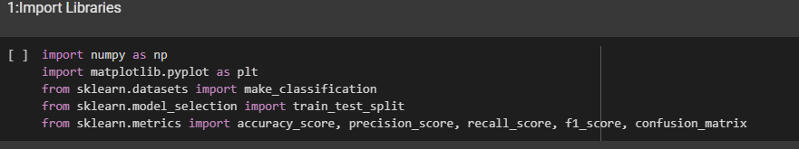
What’s Happening Here?
We’re importing tools that will help us build and evaluate our logistic regression model. Think of these libraries as the "toolbox" for this project:
numpy: Handles all the math and matrix operations we need.
matplotlib: Lets us create visualizations like graphs and charts.
sklearn: Provides ready-to-use functions for generating synthetic data, splitting datasets, and calculating performance metrics.

Slide 4
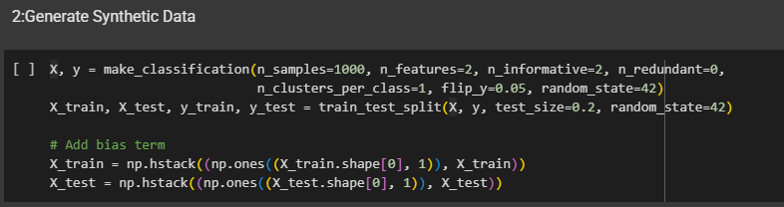
What’s Happening Here?
We’re creating a fake dataset to work with. This dataset has 1000 samples, each with 2 features (like height and weight), and the goal is to predict whether something belongs to one class or another (binary classification).
make_classification: Generates the data. We add a bit of noise (flip_y=0.05) to make it more realistic—just like how real-world data isn’t perfect.
train_test_split: Divides the data into two parts: training data (80%) and testing data (20%). The model learns from the training data and is tested on the testing data to see how well it performs.
Bias Term : We add a column of ones to the feature matrix. This allows the model to account for a constant term (bias) when making predictions

Slide 5
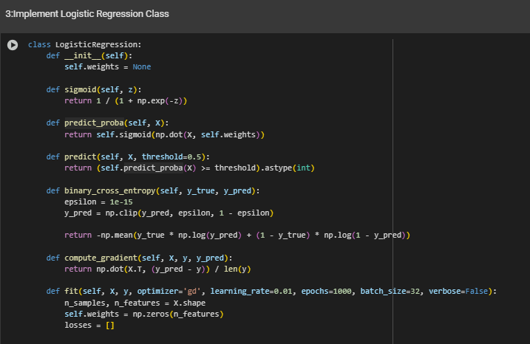

Slide 6
3. Logistic Regression Class
What’s Happening Here?
This is where we define the logistic regression model. It’s like giving the computer a recipe for how to learn from the data:
sigmoid(z) : This function squishes any number between 0 and 1. It’s used to convert raw predictions into probabilities. For example, if the model predicts a value of 2, the sigmoid function converts it into something like 0.88, which means the model is 88% confident the sample belongs to the positive class.
predict_proba(X) : Uses the sigmoid function to calculate the probability of each sample belonging to the positive class.
predict(X, threshold=0.5) : Converts probabilities into binary predictions. If the probability is above 0.5, it predicts “positive” (1); otherwise, “negative” (0).
binary_cross_entropy(y_true, y_pred) : Measures how wrong the model is. Lower values mean the model is doing better. This is like a scorecard for the model during training.
compute_gradient(X, y, y_pred) : Calculates how much the weights need to be adjusted to reduce the error. It’s like figuring out which direction to move to get closer to the right answer.
fit(...) : Trains the model using one of four optimization techniques (Gradient Descent, Batch Gradient Descent, Stochastic Gradient Descent, Mini-Batch Gradient Descent). This is where the model learns from the data

Slide 7
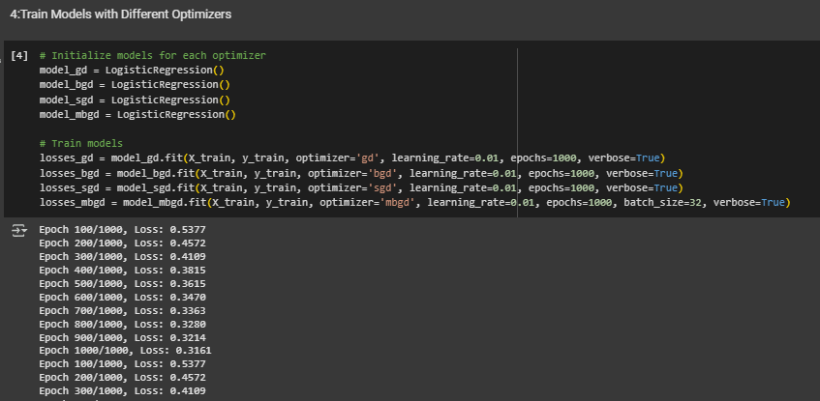

Slide 8
4. Training with Different Optimizers
What’s Happening Here?
We’re training the model using four different optimization techniques. Each optimizer updates the model’s weights in a slightly different way:
Gradient Descent (GD) : Looks at the entire dataset at once to update the weights. It’s thorough but can be slow for large datasets.
Batch Gradient Descent (BGD) : Same as GD in this implementation since both use the full dataset.
Stochastic Gradient Descent (SGD) : Updates weights one sample at a time. It’s faster but noisier because it doesn’t look at the whole dataset at once
.
Mini-Batch Gradient Descent (MBGD) : A compromise between GD and SGD. It updates weights using small batches of data, balancing speed and stability

Slide 9
4. Describe the output of training the model with the different optimizers :
Training Progress: During the training process, you'll see lines printed to the console indicating the current epoch and the corresponding loss value for each optimizer. This output is controlled by the verbose=True parameter in the fit method. It helps you monitor the training progress and see if the loss is decreasing over time.

Slide 10
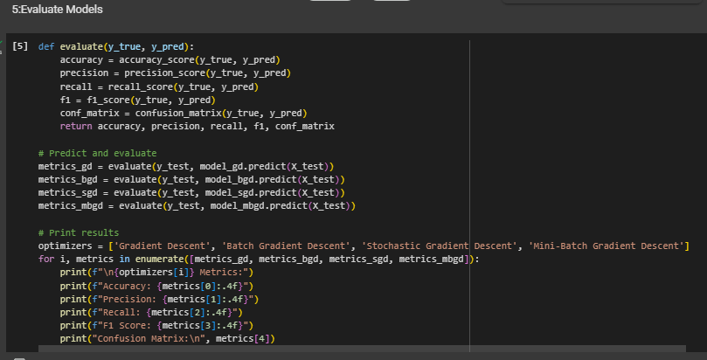

Slide 11
5:Evaluate Models
What’s Happening Here? After training, we evaluate how well the model performs on the test data. These metrics give us a clear picture of the model’s strengths and weaknesses:Accuracy : How often the model gets it right overall.
Precision : How reliable the model is when it predicts “positive.”
Recall : How good the model is at finding all the actual positives.
F1 Score : A balance between precision and recall.
Confusion Matrix : A table that shows true vs. predicted classifications. It helps identify where the model is making mistakes

Slide 12
Describe the output of evaluation of Models
Evaluation Metrics: After the training is completed, the code evaluates the performance of each model on the test data (X_test, y_test) and prints several evaluation metrics:
Accuracy: The proportion of correctly classified samples.
Precision: Out of all the samples predicted as positive, how many were actually positive.
Recall: Out of all the actual positive samples, how many were correctly predicted as positive.
F1 Score: A balanced measure that considers both precision and recall.
Confusion Matrix: A table showing the number of true positives, true negatives, false positives, and false negatives.

Slide 13
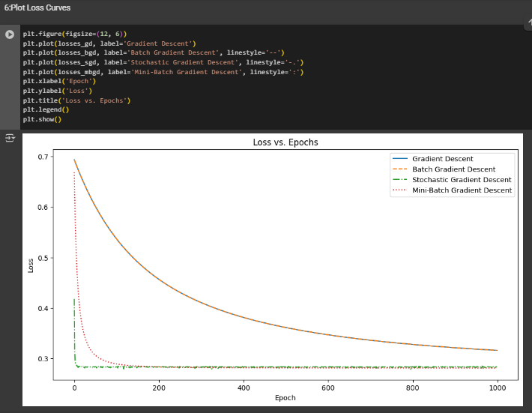

Slide 14
6:Plot Loss Curves
What’s Happening Here? We’re visualizing how the loss changes over time for each optimizer. A loss curve shows how quickly the model is learning:A steep drop means the model is improving rapidly.
A flat line means the model has stopped learning or is stuck.
Comparing the curves helps us see which optimizer converges fastest and most reliably

Slide 15
THANK YOU

